Slide 1
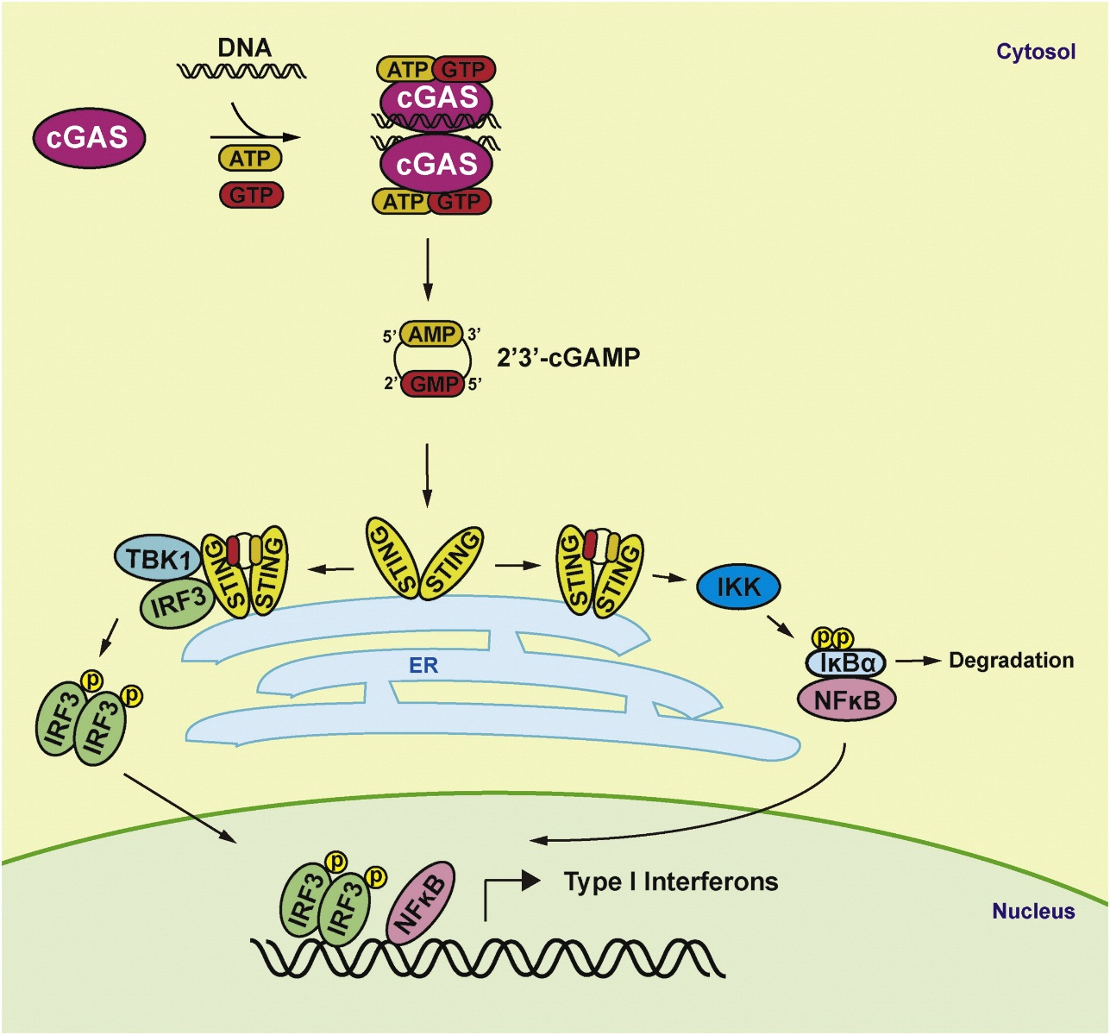
Figure 1
cGAS is the cytosolic DNA sensor
Molecular Cell 2014 54, 289-296DOI: (10.1016/j.molcel.2014.03.040)
Notes:
Model for cGAS-Mediated Cytosolic DNA Sensing
Cytosolic DNA activates cGAS to form a dimeric cGAS-DNA complex which synthesizes 2′3′-cGAMP from ATP and GTP. As a high-affinity ligand for STING, 2′3′-cGAMP binds and activates STING through a series of structural changes. Activated STING then recruits TBK1 to phosphorylate IRF3 and activate IKK to phosphorylate IκBα, leading to IκBα degradation. IRF3 subsequently dimerizes and translocates into the nucleus along with NF-κB to induce the production of type I IFNs and other cytokines.

Slide 2
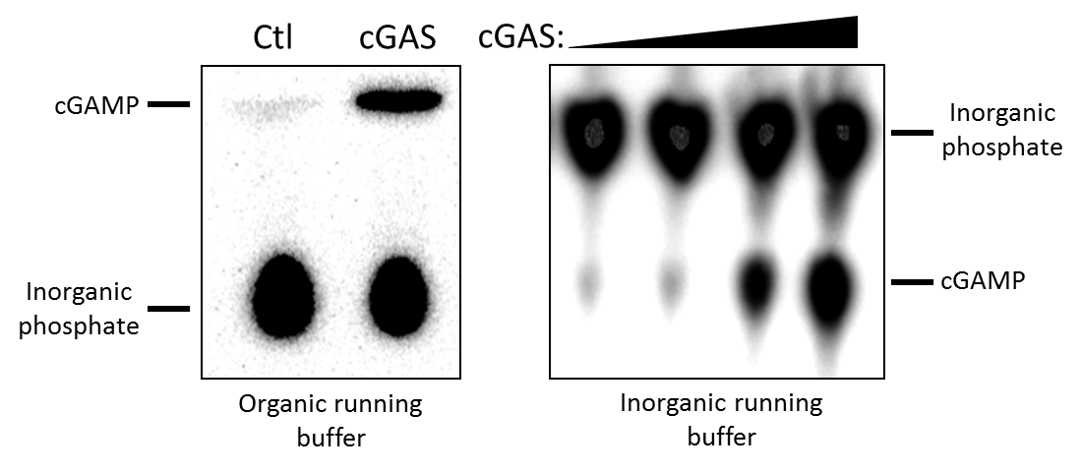
In vitro reconstituted cGAS activity assay
L929 S20 or recombinant cGAS protein
(cGAS activity)
DNA, BSA, ATP, GTP, Mg²⁺, etc.
37°C, 30min
95°C, 5min
+
cGAMP
PFO
THP-1 ISG-lucia cell
Thin Layer Chromatography (TLC)
(w/ [α-³²P]-ATP)
o/n
Luciferase Activity Test
Assay developed by Josh

Slide 3
In vitro reconstituted cGAS activity assay
L929 S20 or recombinant cGAS protein
(cGAS activity)
THP-1 S20 (or Fraction)
(inhibitor activity)
0°C, 30min
+
DNA, BSA, ATP, GTP, Mg²⁺, etc.
±
37°C, 30min
95°C, 5min
cGAMP
PFO
THP-1 ISG-lucia cell
Thin Layer Chromatography (TLC)
(w/ [α-³²P]-ATP)
o/n
Luciferase Activity Test
Track the inhibitor activity (decrease of cGAMP signal)

Slide 5
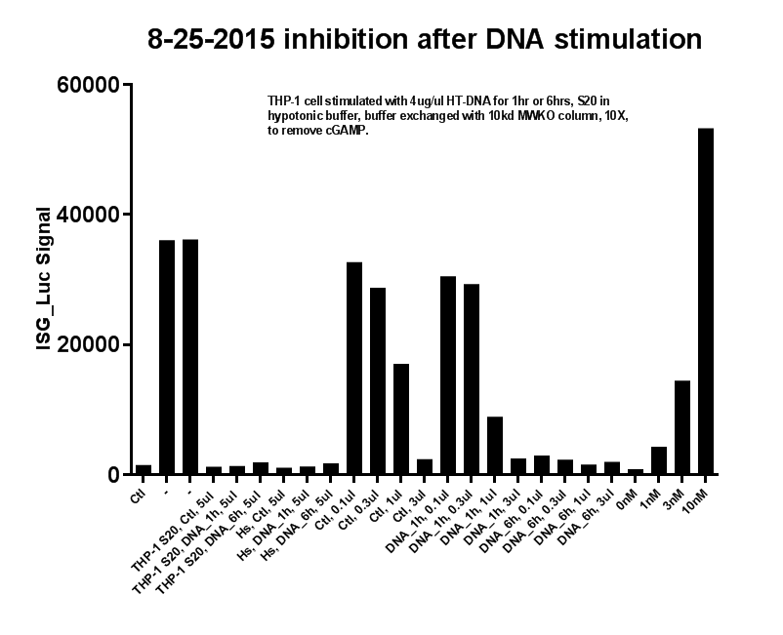
DNA stimulation test

Slide 6
Column Summary Table
 | Activity | Yield | Fold | Note
40% AmSO₄ cut | About half in sup, half in pellet | ~50% | 3-4x | Use
Mono S | FT |  | ~1x | Not use
HiTrap Q HP | Bind | ~100% | ~5x | Good
Mono Q | ~70%B | 30% | 15x | Good
Superose 6 | Void Volumn | 80% | 4x | Use
Phenyl | FT | ~60% | 1.5x | Not use
Blue | FT and 25%B | 30% | ~4x | Use
CHT | 50%B and 100%B | 15-20% | 50x | Good
Octyl | FT | 20% | 2x | Not use
cGAS affinity | FT | 70% | ? | Not use
ANX FF | 100%B | ~100% | ? | Not use
Q FF | 100%B | ~100% | ? | Not use
Heparin HP | FT | ? | ? | Not use
Glycerol Gradient (10%~50%) | Bottom | ? | ? | -
Notes:
4% highly cross-linked agarose instead of 6%

Slide 7
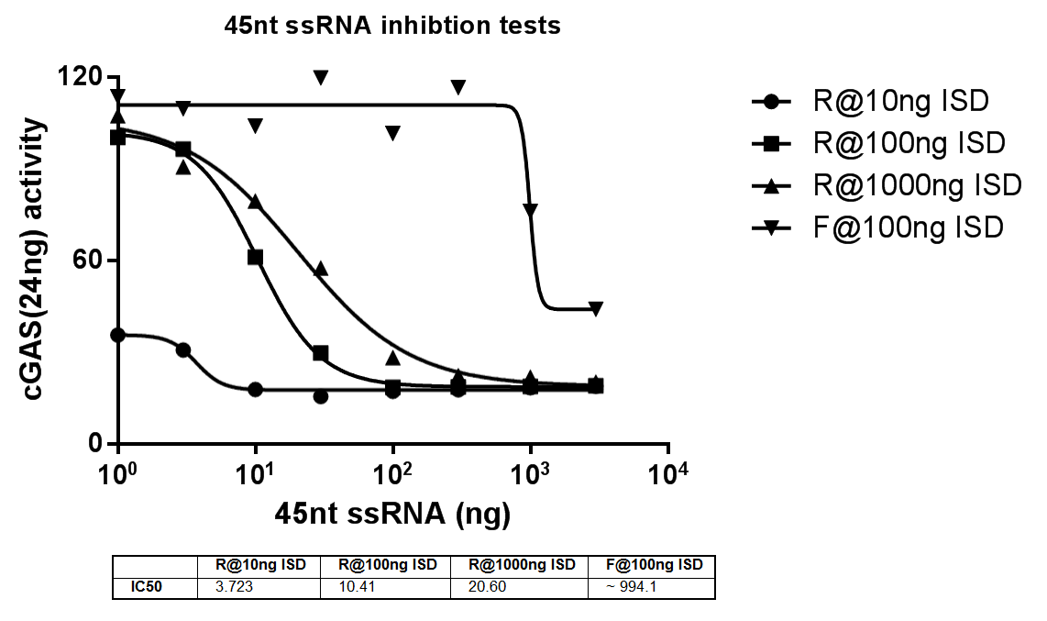
~25nM
~250nM
~2.5uM
~30nM
~50nM

Slide 8
Bind to Q column quite well and CHT column
It’s very big/heavy complex (eluted in void volume on gel filtrations, major activity in P100, or in the bottom fraction of glycerol/sucrose gradient centrifugation)
It is sensitive to Benzonase (an enzyme that digest both RNA and DNA) treatment.

Slide 9
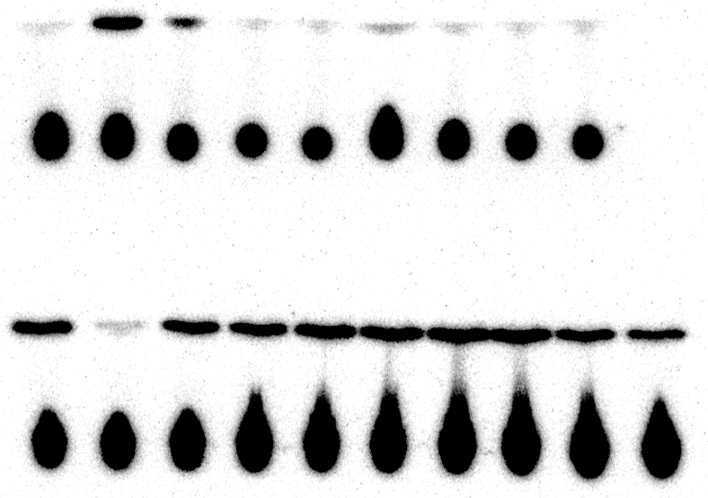
25nt ssDNA F (ng)
25nt ssDNA R (ng)
45nt ssDNA F (ng)
45nt ssDNA R (ng)
-
45nt ssRNA R
30ng
30
60
30
60
30
60
30
60

Slide 10
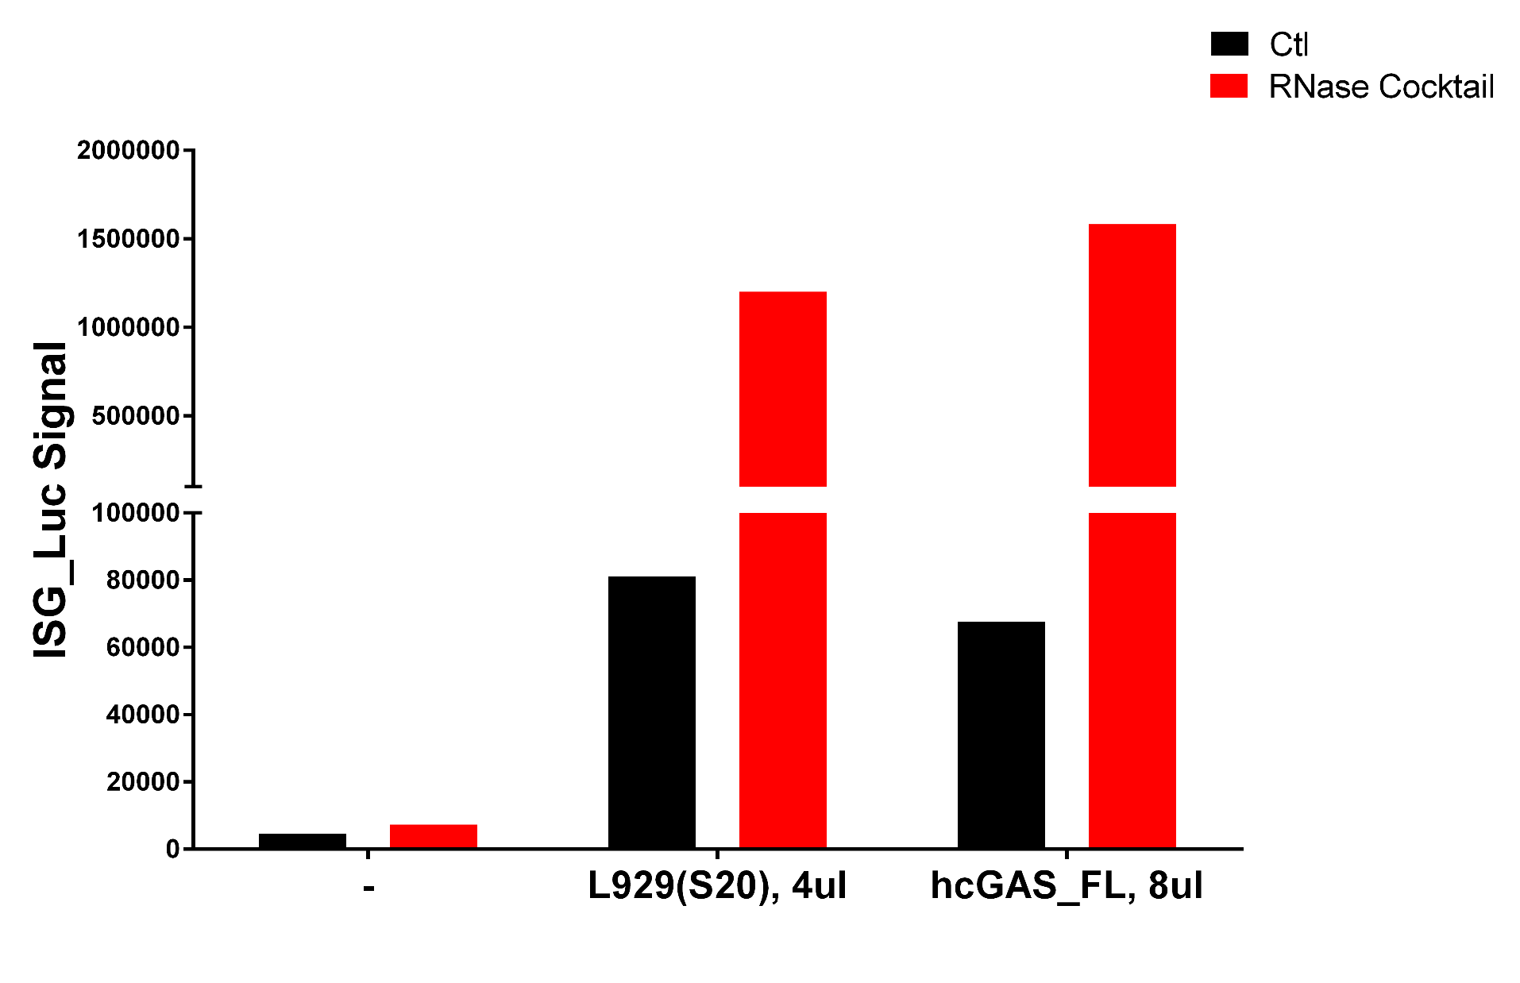
RNase can significantly enhance cGAS activity
23x folds
15x folds
Previous data

Slide 11
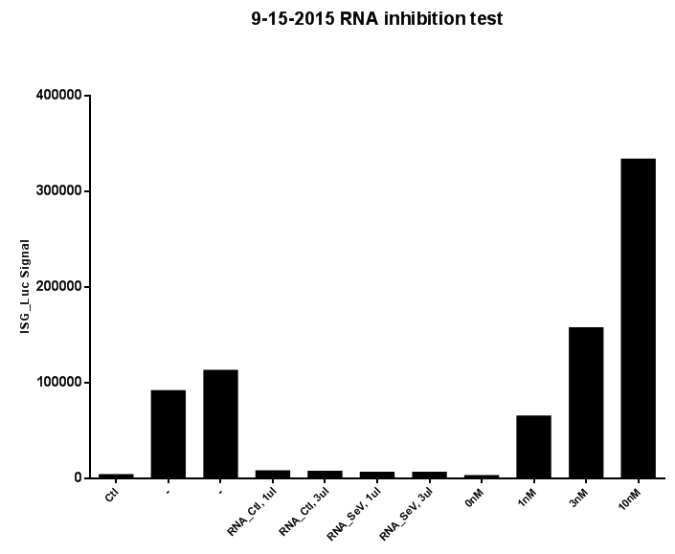
RNA can inhibit cGAS activity
Total RNA extracted from THP-1 cell S20 (Ctl and SeV stimulated) can inhibit cGAS activity in L929 S20.
Previous data

Slide 12
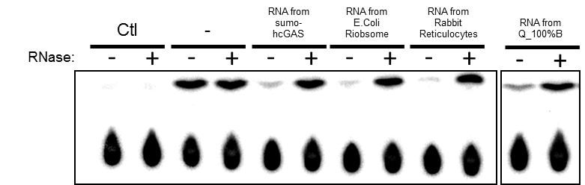
Inhibition of cGAS by RNA can be abolished by RNase
In all groups, 30ng of RNA was used; RNase used here is the RNase cocktail; For all reactions, 25ng cGAS with 100ng ISD is used in 15ul reaction.

Slide 13
Properties of putative cGAS inhibitor (from previous work)
Bind to Q and CHT column quite well
It’s very big/heavy complex (eluted in void volume on gel filtrations, major activity in P100, or in the bottom fraction of glycerol/sucrose gradient centrifugation)
Heat sensitive (95 degree, 5min would kill the activity)
It “changes” after Benzonase treatment (molecular weight becomes smaller but with very low recovery)
RNase treatment kills 90% of the inhibitory activity in Q_100%B
RNase treatment kills 70% of the inhibitory activity in S20, 90% of the remaining activity is in the pellet fraction.
RNase increase the activity of recombinant cGAS and also cGAS in L929 S20 (the effect is much more significant for L929 S20, a. more RNA binds to cGAS in S20; b. much less cGAS protein in L929 S20; c. Detection method, RNase increase the response of cells to cGAMP delivery)
RNA extracted from 293T, L929 and THP-1 cells can potently inhibit cGAS activity
Inhibitory effect from RNA is not heat sensitive

Slide 14
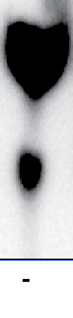
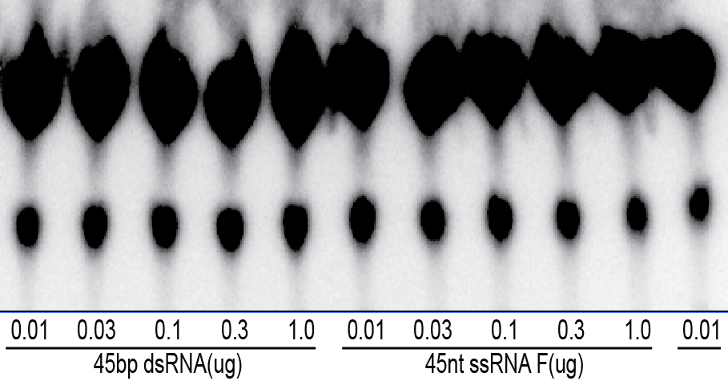
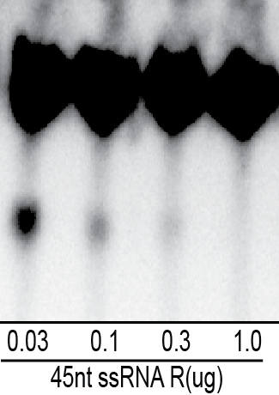
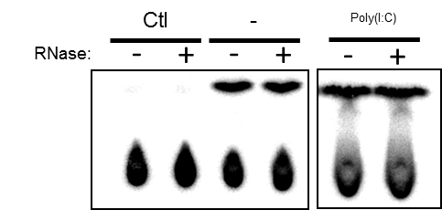
Synthetic ssRNA have potent cGAS inhibitory effect
Inorganic
phosphate
cGAMP
45nt ssRNA F: AAACAAAAACAAAACAAACAACACAACAAACAAAACAAAAACAAA
45nt ssRNA R: UUUGUUUUUGUUUUGUUUGUUGUGUUGUUUGUUUUGUUUUUGUUU
45bp dsRNA: annealed from 45nt ssRNA F&R

Slide 15
Synthetic ssDNAs do NOT inhibit cGAS activity
25nt ssDNA F (ng)
25nt ssDNA R (ng)
45nt ssDNA F (ng)
45nt ssDNA R (ng)
-
45nt ssRNA R
30ng
30
60
30
60
30
60
30
60
@24ng hcGAS w/ 100ng ISD
25nt ssDNA F: AAACAAAAACAAAACAAACAACACA
25nt ssDNA R: TTTGTTTTTGTTTTGTTTGTTGTGT
45nt ssDNA F: AAACAAAAACAAAACAAACAACACAACAAACAAAACAAAAACAAA
45nt ssDNA R: TTTGTTTTTGTTTTGTTTGTTGTGTTGTTTGTTTTGTTTTTGTTT

Slide 16
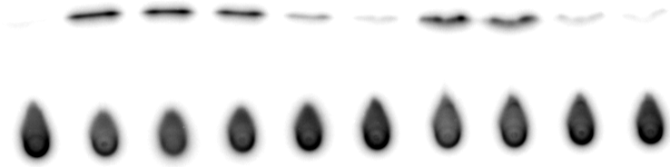
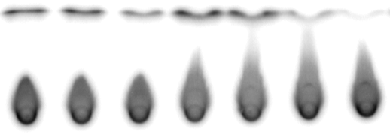
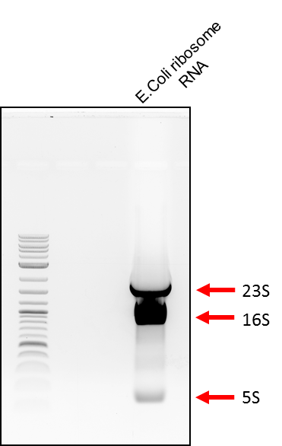
Both 16S and 23S E.coli rRNA inhibits cGAS
23S E.coli Ribosome RNA
(2900nt) (ng)
16S E.coli Ribosome RNA
(1500nt) (ng)
5S E.coli Ribosome RNA (ng)
E.coli Ribosome RNA
(ng)
Ctl
-
1
3
10
30
1
3
10
30
1
3
10
1
3
10
30
0.9nM
1.7nM
cGAS: 30nM
ISD: 220nM

Slide 17
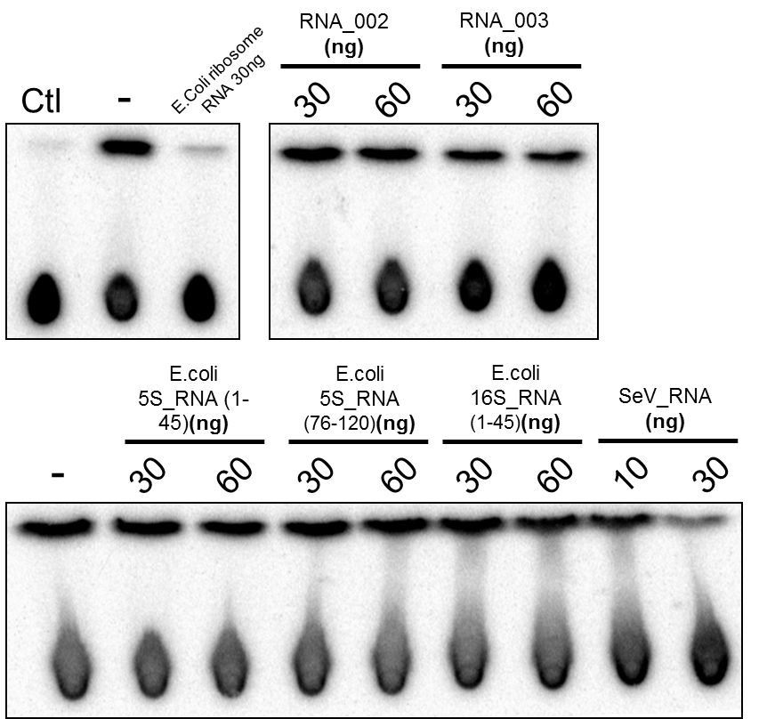
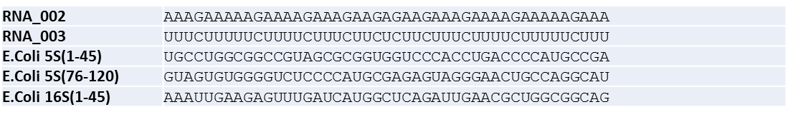
ssRNA inhibits cGAS in sequence dependent manner
Changing U->A
Changing G->C

Slide 18
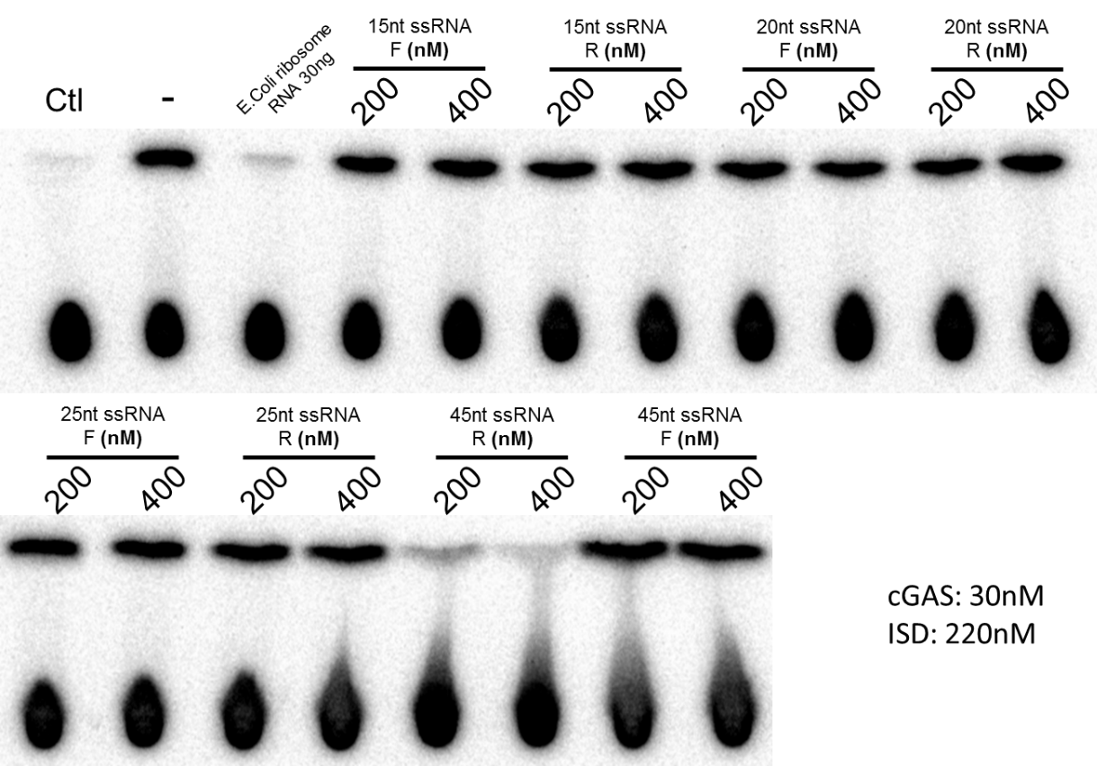
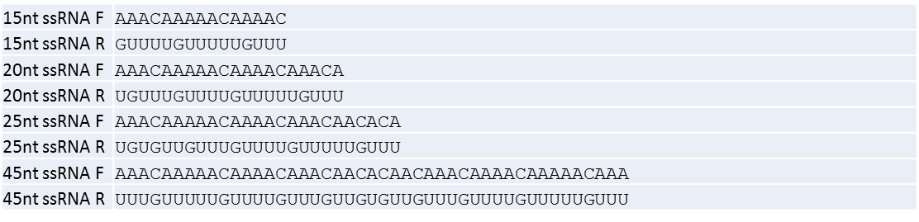
Shorter version of ssRNA R does NOT inhibit cGAS

Slide 19
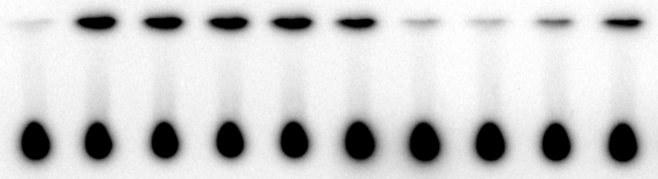
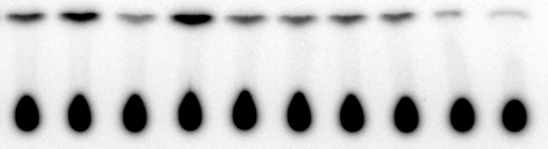
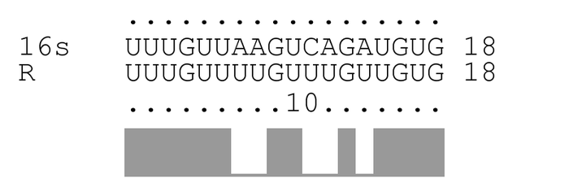
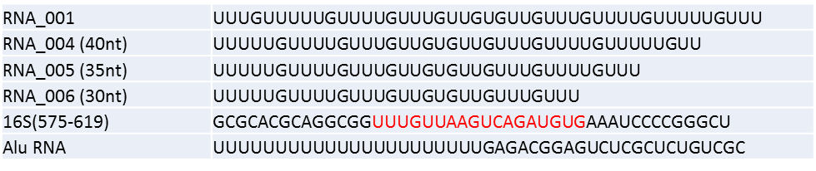
40nt ssRNA R does NOT inhibit cGAS (RNA_004)
E.coli 16S rRNA fragment inhibits cGAS
Ctl
-
RNA_001
RNA_004
16S(575-619)
E.Coli ribosome
RNA 30ng
45nt ssRNA R
RNA_005
RNA_006
Alu_RNA
cGAS: 30nM
ISD: 220nM
Oligo: 400nM

Slide 20
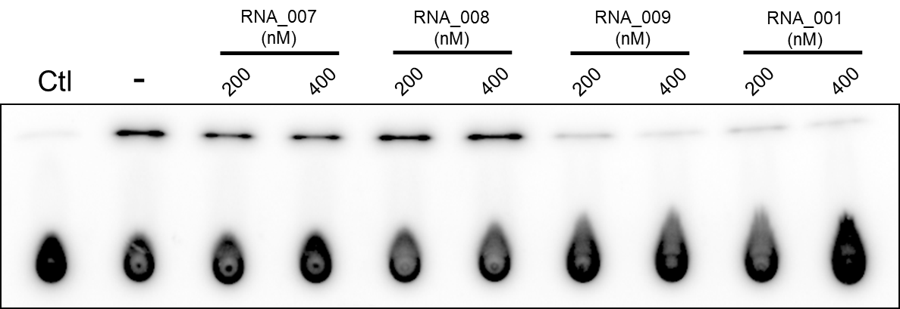
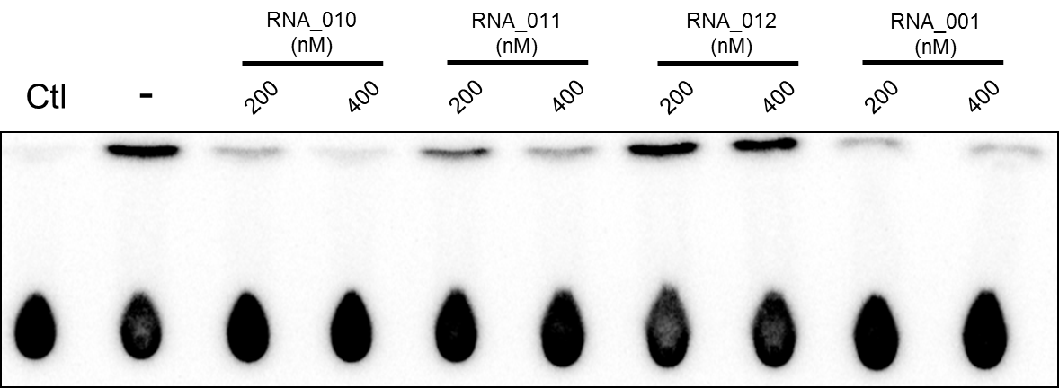
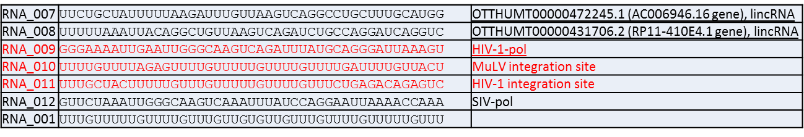
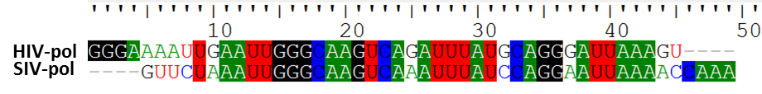
HIV pol CDS fragment inhibits cGAS (but not fragment from SIV)
cGAS: 35nM
ISD: 220nM

Slide 21
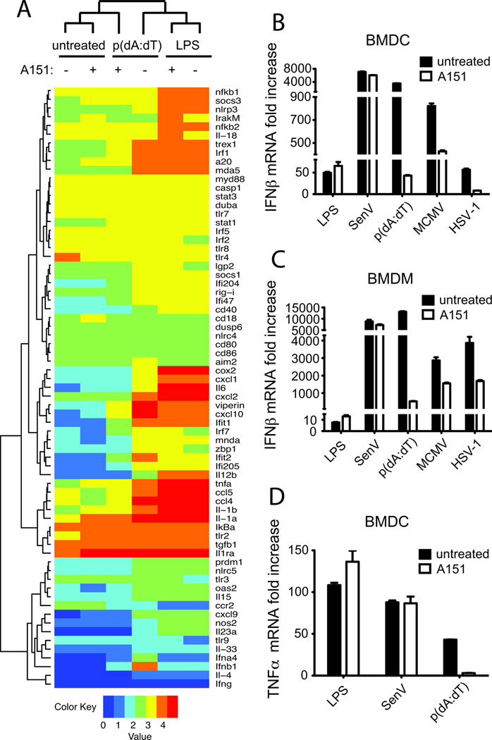
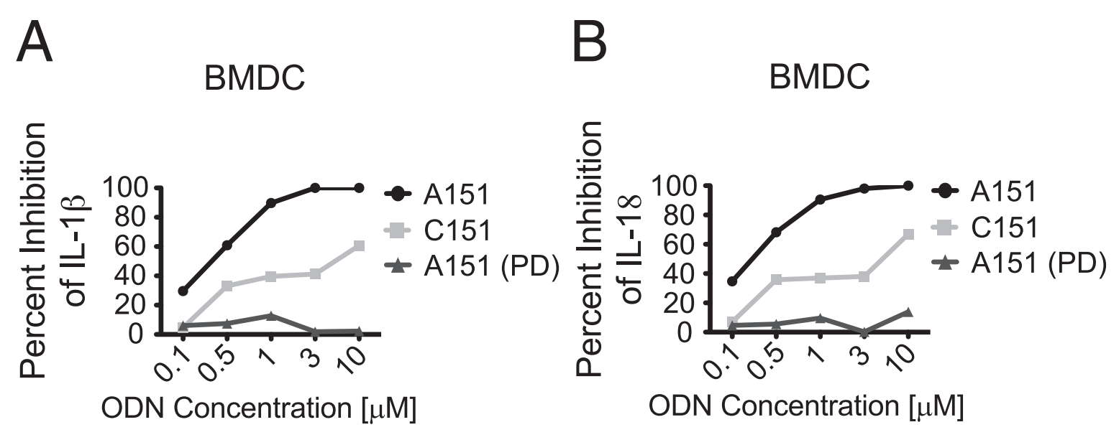
PS-bond DNA inhibits AIM2 pathway
Kaminski, John J., et al. "Synthetic oligodeoxynucleotides containing suppressive TTAGGG motifs inhibit AIM2 inflammasome activation." The Journal of Immunology 191.7 (2013): 3876-3883.

Slide 22
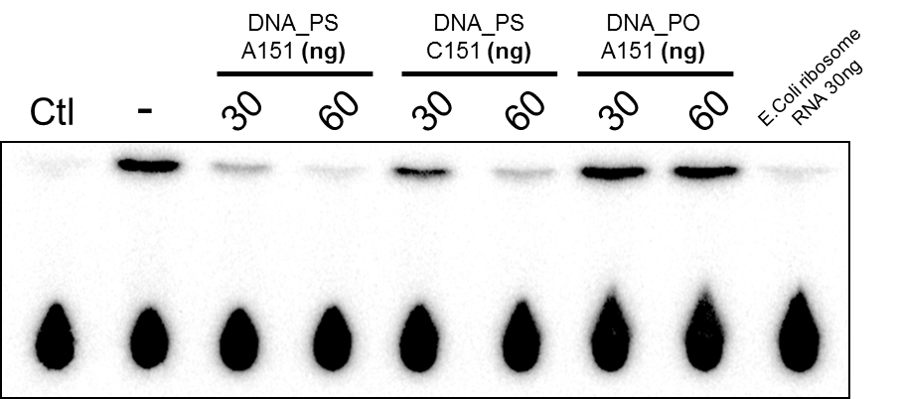
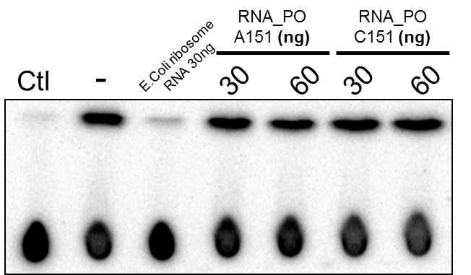
PS ssDNA inhibits cGAS (sequence independent)
120nM
DNA_PS_A151 | T*T*A*G*G*G*T*T*A*G*G*G*T*T*A*G*G*G*T*T*A*G*G*G
DNA_PS_C151 | T*T*C*A*A*A*T*T*C*A*A*A*T*T*C*A*A*A*T*T*C*A*A*A
DNA_PO_A151 | TTAGGGTTAGGGTTAGGGTTAGGG
RNA_PO_A151 | UUAGGGUUAGGGUUAGGGUUAGGG
RNA_PO_C151 | UUCAAAUUCAAAUUCAAAUUCAAA
cGAS: 30nM
ISD: 220nM
Notes:
BMDCs were primed with LPS (200ng/ml) and challenged with 300ng of poly(dA:dT) complexed with lipofectamine 2000 (untreated).

Slide 23
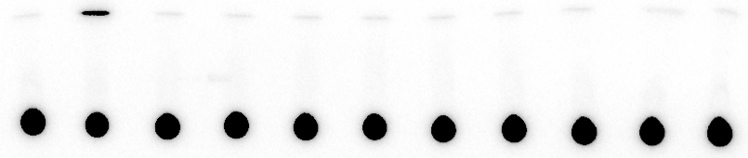
In vitro transcribed HIV genome RNA fragments inhibit cGAS activity
HIV-RNA_
2-4kb (ng)
HIV-RNA_
4-6kb (ng)
HIV-RNA_
6-8kb (ng)
HIV-RNA_
8-end (ng)
RNA_001
400nM
Ctl
-
300
800
300
800
300
800
300
800
DNA templates with T7 promoter were PCR amplified from HIV vector pNL4-3-dE-EGFP
cGAS: 35nM
ISD: 220nM
HIV_RNA:
300ng ~ 30nM

Slide 24
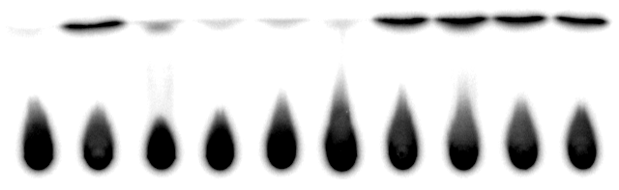
Cas9 mRNA (random mRNA?) inhibits cGAS activity in vitro
RNase -
RNase +
Cas9 mRNA:
(ng)
Ctl
0
100
300
500
Ctl
0
100
300
500
cGAS: 35nM
ISD: 220nM

Slide 25
Oligo Summary
RNA sequence specificity?

Slide 26
Is the putative cGAS inhibitor RNA?
Pros:
It binds to Q column(negatively charged) and CHT column with high salt (PO₄ group)
Sensitive to RNase treatment (kill >50% activity in S20 or >80% activity of Q_100%B)
Most of the activity recovered with Trizol extraction of Q_100%B (>80%)
Some sequence specificity in “RNA inhibitor” (45nt ssRNA R but not F or 45bp dsRNA will inhibit)
Non-competitive inhibition
Cons:
Sensitive to heat when in S20
RNase can NOT totally kill the activity in S20
So far, have NOT seen cell type specificity or inducible
Unknown specificity of the inhibition? (ribosomal RNA, tRNA, miRNA, etc. )

Slide 27
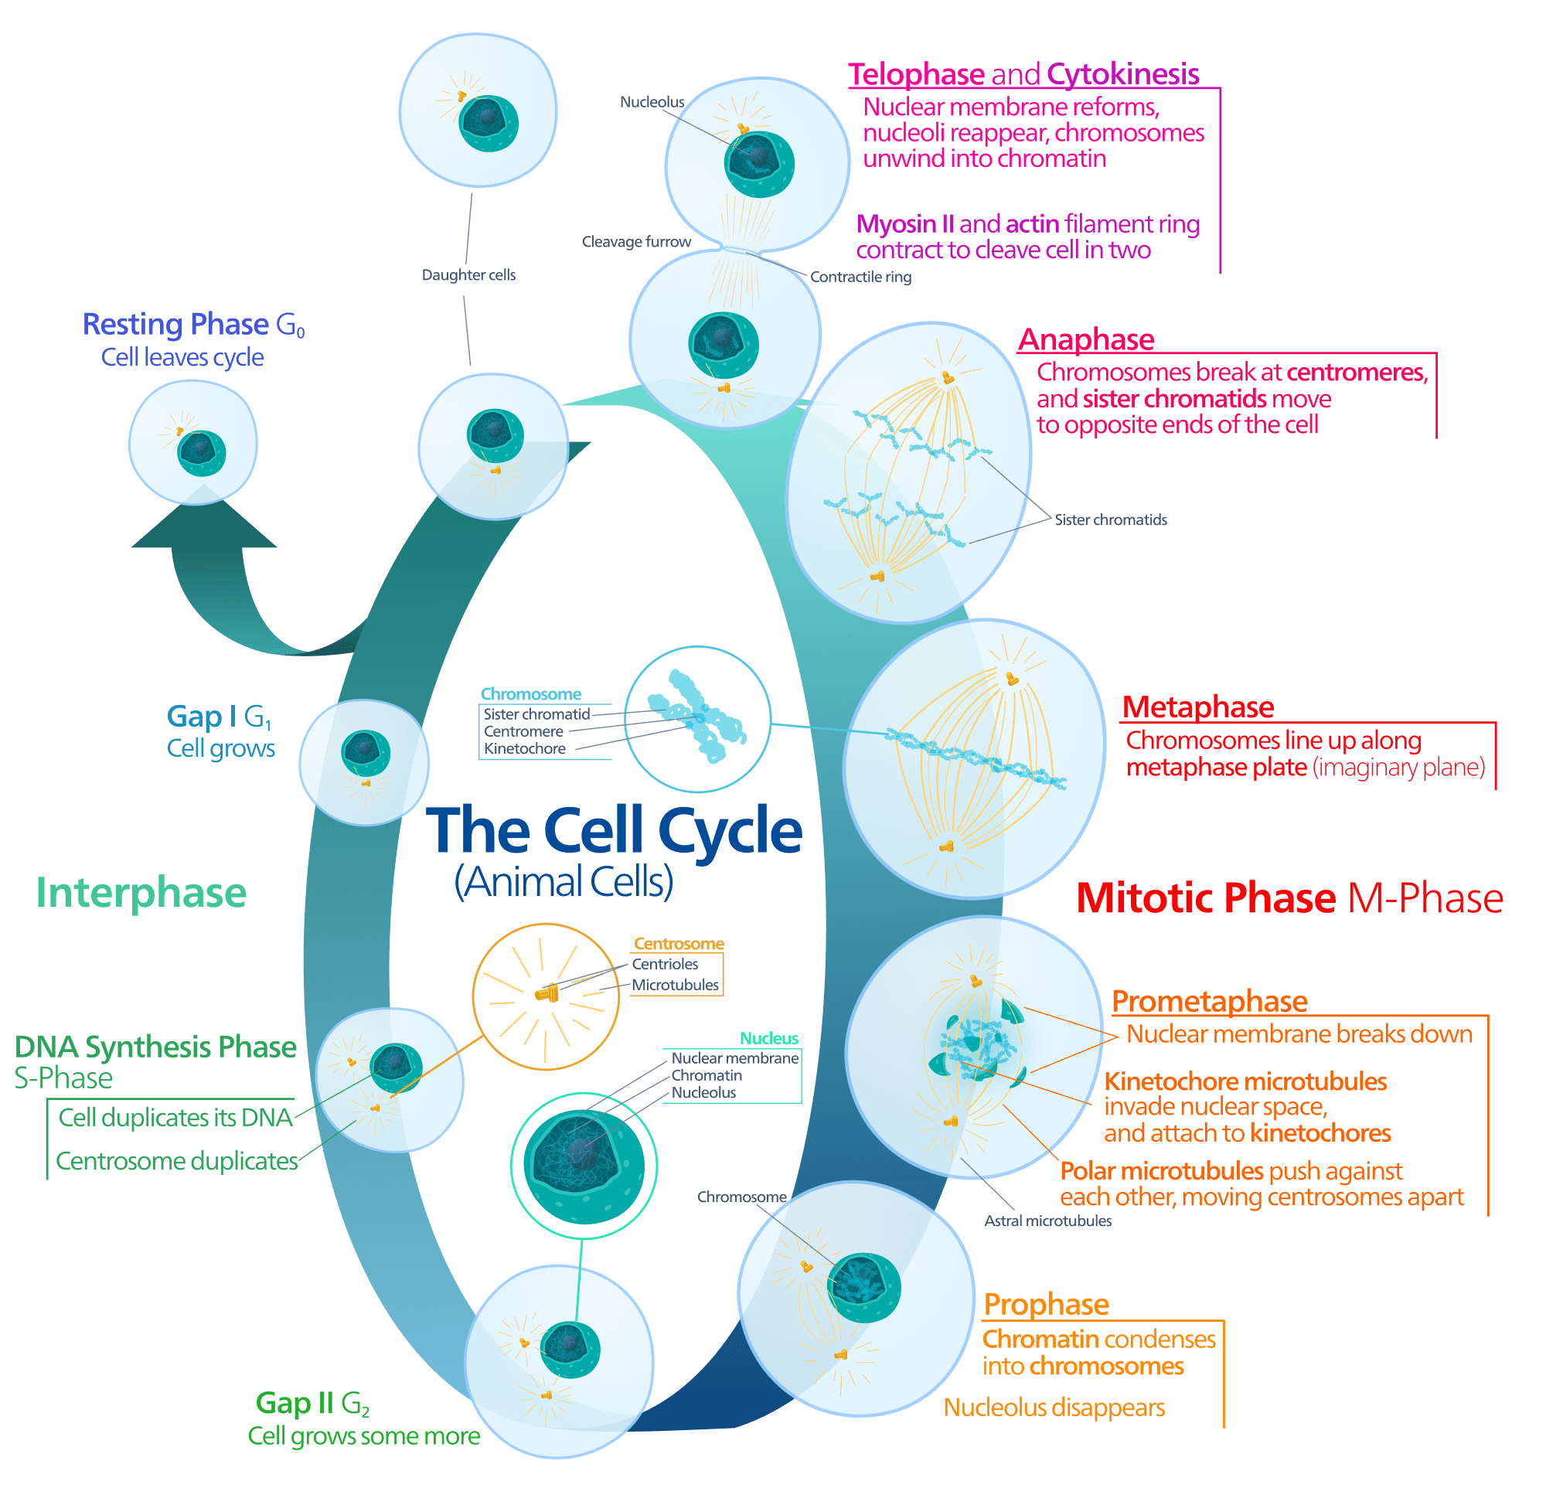
Cell cycle
File:Animal cell cycle-en.svg. (2017, January 14). Wikimedia Commons, the free media repository. Retrieved04:46, September 7, 2017
from https://commons.wikimedia.org/w/index.php?title=File:Animal_cell_cycle-en.svg&oldid=229739070.

Slide 28
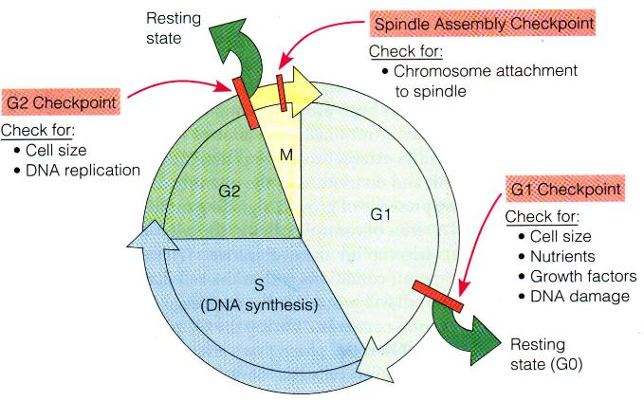
Cell cycle and checkpoints
Nocodazole treatment
Thymidine treatment
https://oncogenesandcancer.wordpress.com/cell-cycle-checkpoints-and-effect-of-oncogenes-2/
Notes:
High concentration of thymidine interrupts the deoxynu- cleotide metabolism pathway, thereby halting DNA replication.

Slide 29
Hela_FG-GFP-cGAS stable cellline
Notes:
First, we thought it was something to do with the GFP and individual clones, so
Use N-term or C-term GFP tagged cGAS
Pick single clones and check

Slide 30
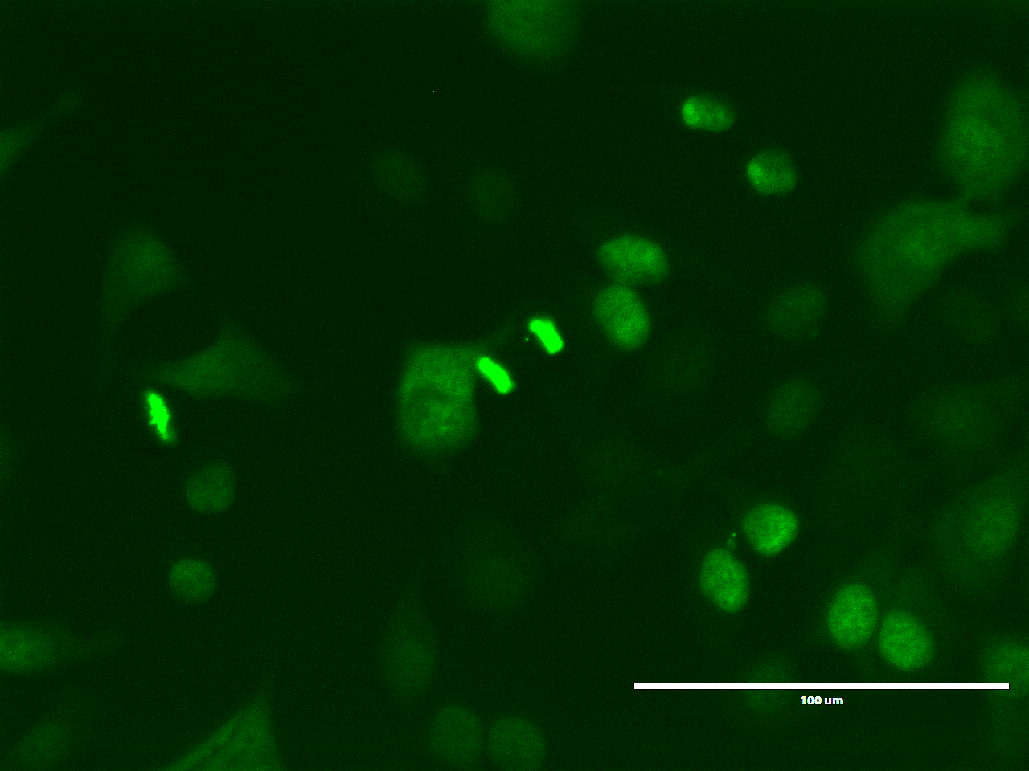
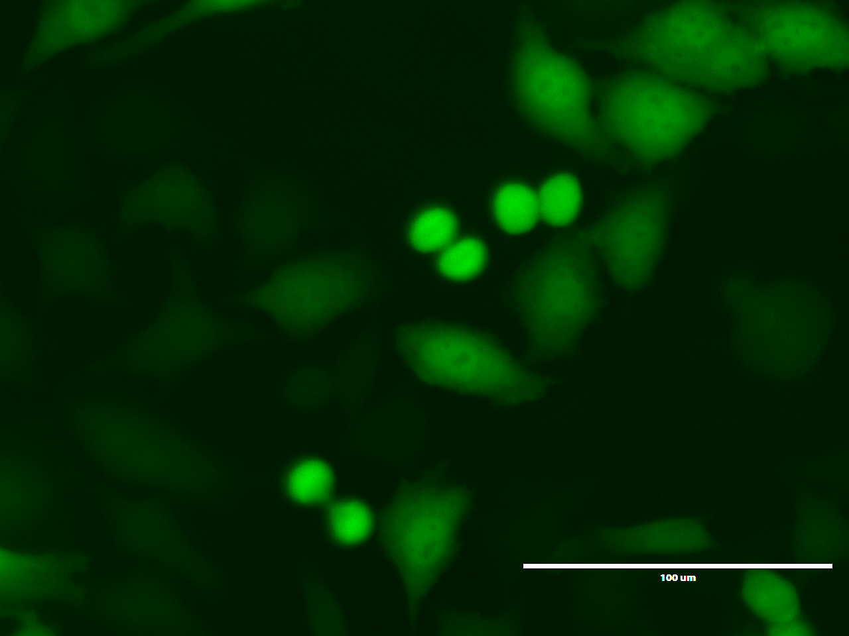
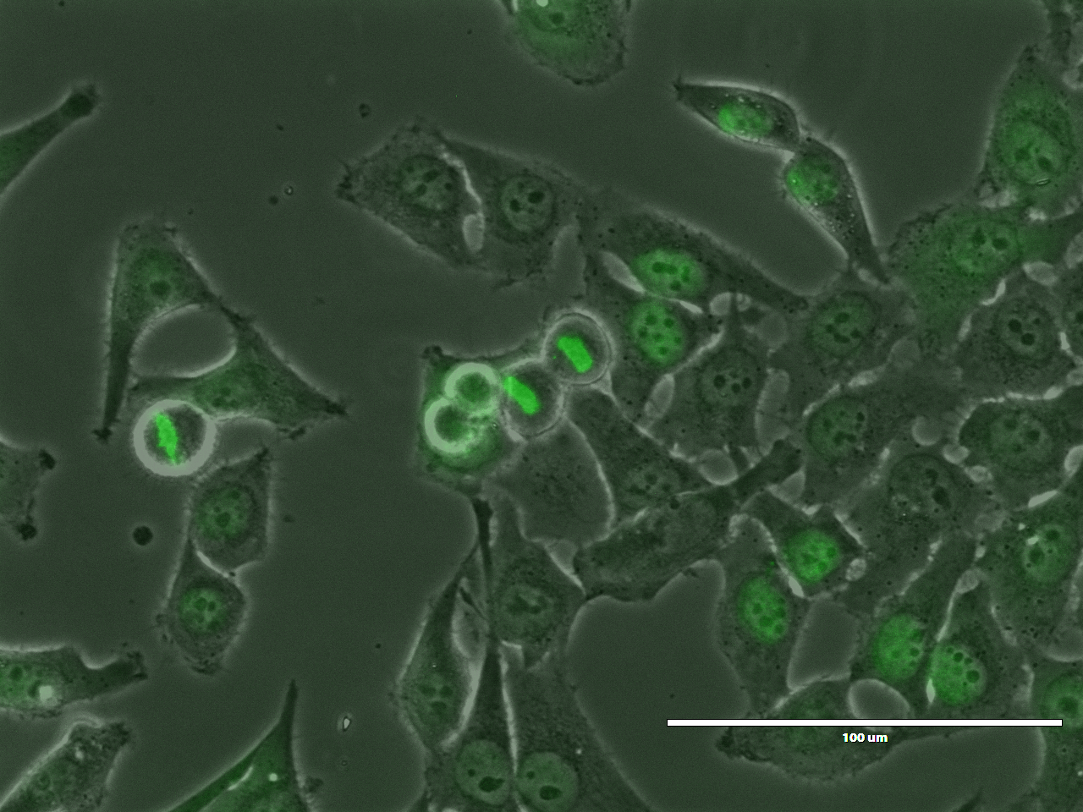
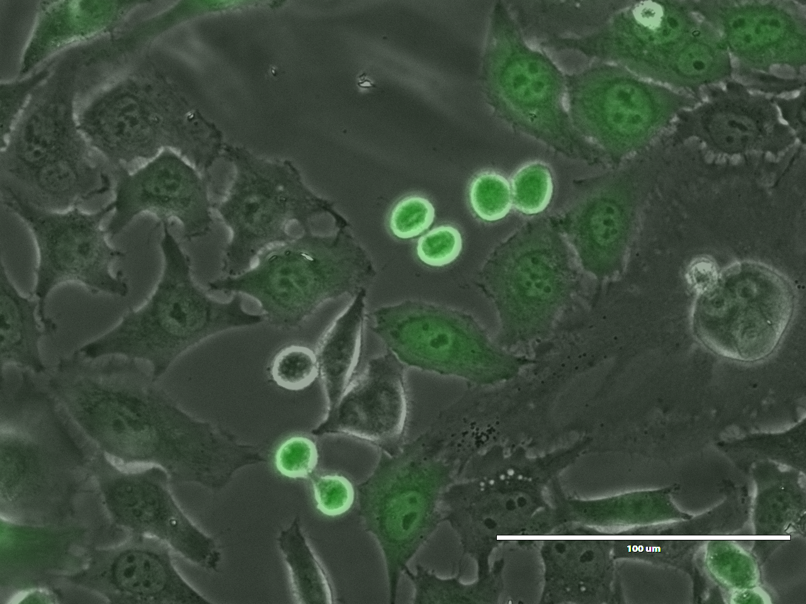
Hela_FG-GFP-cGAS
Hela_GFP

Slide 31
Hela_FG-GFP-cGAS (treated with 100ng/ml Nocodazole for 12 hours)

Slide 32
Hela_GFP (treated with 100ng/ml Nocodazole for 12 hours)

Slide 33
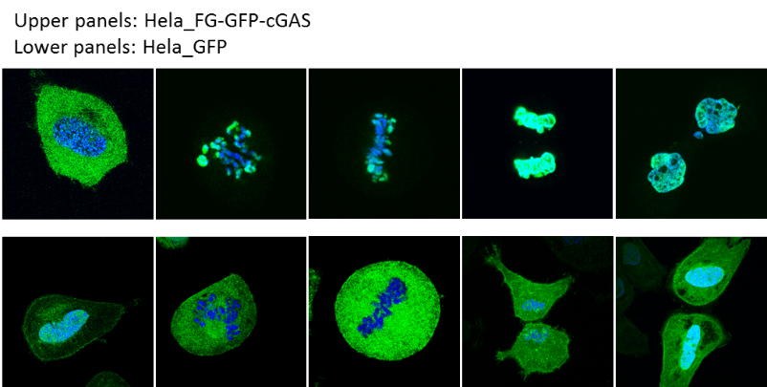
cGAS is translocated to the nucleus during cell cycle
G1/S
Prometaphase
metaphase
Telophase
cytokinesis
Notes:
When the cells are arrested at G1/S/G2 phase for enough long time, the majority of the cGAS will be locating in the cytoplasm.

Slide 34
cGAS locates in the RIPA insoluble nuclear fraction
Hela_cGAS KO
Hela_ wt
RIPA_ext
1M extract
Final pellet
RIPA_ext
1M extract
Final pellet
S20
S20
IB:cGAS

Slide 35
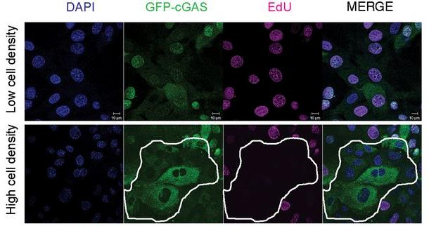
cGAS enters the nucleus in proliferating cells
Hui Yang et al. PNAS 2017;114:E4612-E4620

Slide 36
Summary_1
The localization of cGAS is dynamic with the stages of mitosis.
Majority of cGAS bind to chromosomes during cell division
cGAS is localized in the cytoplasm of non-dividing cells but enters the nucleus and associates with chromatin DNA during mitosis in proliferating cells.
Questions:
the cGAS bound to chromatin/chromosome active or not?

Slide 37
ISD transfection to control cells but not Nocodazole synchronized cells produced cGAMP

Slide 38
Hela cell nuclei and lysate extract method
cell pellet + 600ul Hypotonic buffer
sit on ice for 10min, dounce for 20s, 2,000g for 10min
P2
S2, 20,000g for 10min
S20
Add buffer with 0.3M (or 0.5M) NaCl to extract proteins

Slide 39
Test of cGAS activity in the nucleus
cGAS in the nucleus can be activated by ISD.

Slide 40
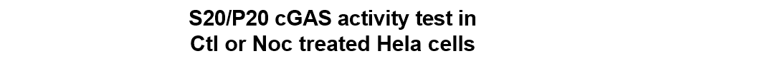
Test of cGAS activity in the Nocodazole treated cells

Slide 41
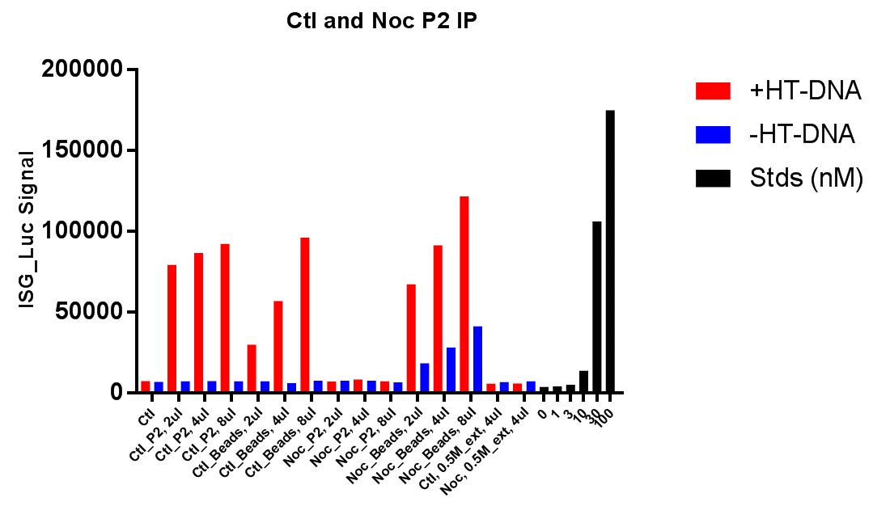
Nuclear fraction(pellet) from Nocodazole treated Hela cell does not have cGAS activity, however, after extraction and IP, the cGAS did have activity, which may exclude the possibility of modification on cGAS that regulates cGAS enzymatic activity.

Slide 42
Summary_2
In control cells (non-M phase cells, cGAS in the nucleus that is bound to chromatin is not activated by chromatin, but it can be activated by addition of ISD to it
When the cell is at M phase, most of cGAS protein is bound to the chromosomes, and at this stage, cGAS is not activated by chromosome and can not be activated by adding of ISD.
Questions:
We have indirect evidence to show that cGAS do bind to chromatin/chromosome through its DNA binding domain, however, what’s the regulation mechanism(s) that prevent cGAS from being activated?

Slide 43
Nuclear fraction(pellet) from Nocodazole treated Hela cell does not have cGAS activity, however, after extraction and IP, the cGAS did have activity, which may exclude the possibility of modification on cGAS that regulates cGAS enzymatic activity.

Slide 44
cGAS activity inhibition assay

Slide 45
Elution_1: IP-Flag-cGAS from 0.4M NaCl extract @ 0.4M NaCl, eluted with 1M NaCl, concentrated and buffer exchanged to 0.5M NaCl. (for 0.1ul and 0.3ul, use hypo to do 1:10 dilution first and use 1ul and 3ul, respectively)
Elution_2: Same as 1 but with freeze and thaw sample as SM
Elution_3: Similar to 1 but IP from S20
This experiment was repeated multiple times and showed similar result (due to uncertainty about salt, Benzonase, etc. )
Notes:
It makes sense that there should be a “real” inhibitor, but we really don’t want to see it’s heat sensitive, since it may indicate something not so good.

Slide 46
Notes:
Since we used 5kda filter to concentrate, it’s not small molecule. So it could be nucleotide (DNA or RNA), though DNA cause the precipitation of cGAS, but the cGAS activity is not that much affected. So the best guess seems to be RNA.

Slide 48
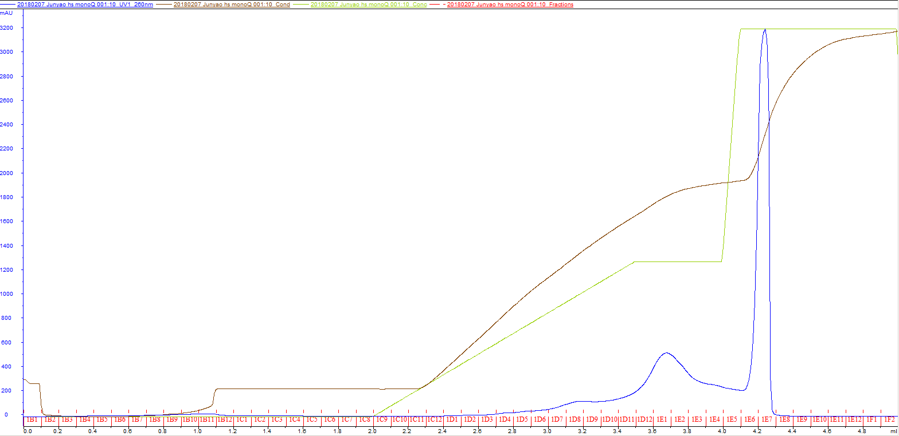
Heat soup on mono-Q column
Column: Mono-Q 0.1mL
Buffer A: 20mM Tris-HCl pH 7.5 + 0.1M NaCl
Buffer B: 20mM Tris-HCl pH 7.5 + 1M NaCl
Histone 2A?

Slide 50
BSA(ng)
10
50
100
D6
D7
D8
D9
D10
D11
D12
E1
E2
E3
E4
E5
E6
E7
250kd
150kd
100kd
75kd
50kd
37kd
25kd
20kd
15kd
10kd
Histone 2A?

Slide 51
3.5ng recombinant cGAS and 0.5ug chromatin for basal cGAS reaction (w/ RNase)

Slide 52
Heated H2B(ug)
H2B(ug)
Heated H2A(ug)
H2A(ug)
0.0625
1
0.0625
1
0.125
0.0625
0.0625
0.25
0.125
0.125
0.125
D10
1
0.5
0.25
0.25
0.25
0.5
1
0.5
0.5
250kd
150kd
100kd
75kd
50kd
37kd
25kd
20kd
15kd
10kd
After heating, about 50% of histone is gone, while 75% of H2A is gone
In terms of cGAS inhibitory activity, the D10 fraction from mono-Q is much stronger than purified histones (approximately 8x stronger than H2B and 16x stronger than H2A)
4ul D10 fraction is equivalent to 0.0625ug H2B, and previously, 1ul of D10 fraction can inhibit more than half of the cGAS activity, comparable to 0.125ug H2B.

Slide 53
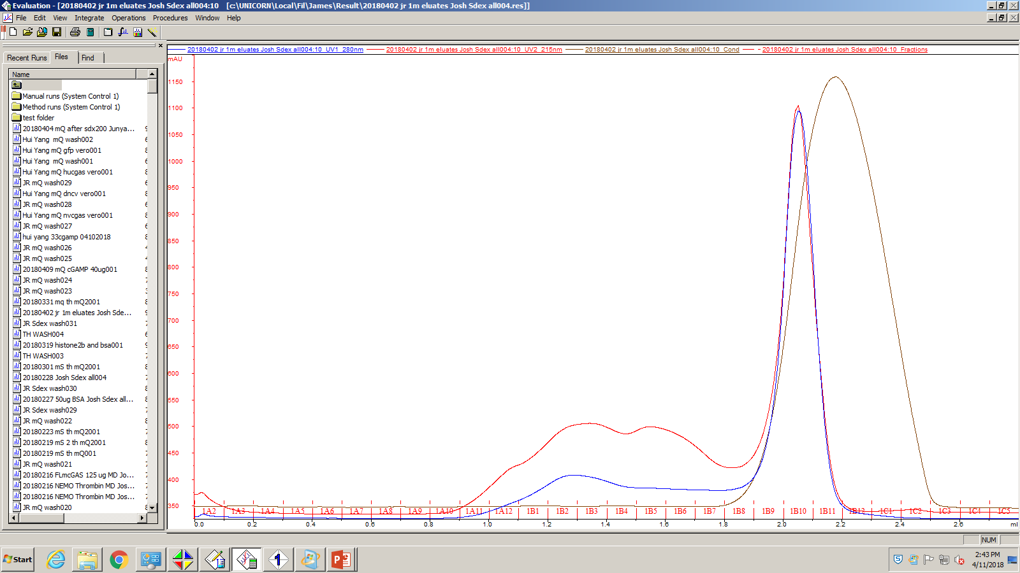

Slide 55
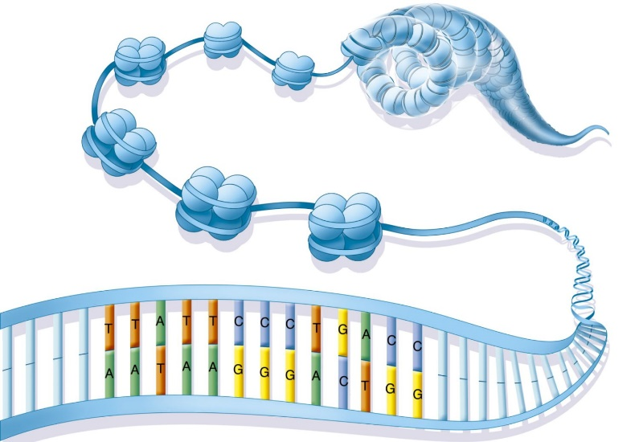
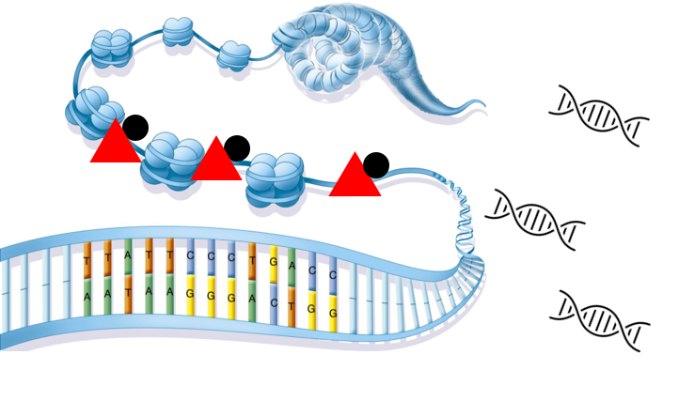
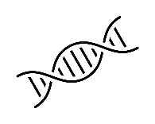
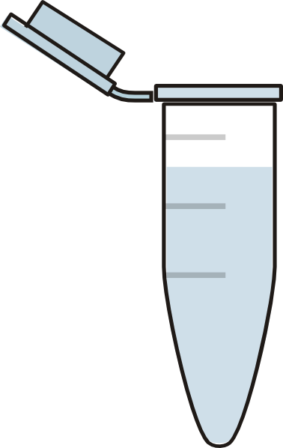
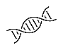
In high salt extraction
In reaction when we low the salt concentration
IP cGAS remove the putative inhibitor
cGAS
cGAMP
Putative inhibitor

